Slide 1
Process and Thread Synchronisation Concepts
Lecture 1 of 4
Mutual Exclusion
Semaphores, Mutexes, Monitors
Producer/Consumer Problems
Events, Conditions and Rendezvous.
Note: Examples of the concepts presented here can be found in the RTExamples folder: Q8
You are encouraged to open the project(s) in Visual Studio and run the program(s)
©Paul Davies 2020. Not to be copied, used, or revised without explicit written permission from the copyright owner. This lecture may contain animations and is best viewed as a slide show

Slide 2
Mutual Exclusion (see http://en.wikipedia.org/wiki/Mutual_exclusion )
There exist in all computer systems, certain resources which are inherently ‘non-sharable’ by two or more tasks if they are not to interact with each other in some detrimental way.
In concurrent systems terminology, we say that access to such resources should be made “mutually exclusive”, i.e. “not at the same time”. The resource can be shared, but only if all tasks co-operate so that only one of them has access the resource at any one time.
Hardware Resources Requiring Mutual Exclusion
Examples of such built in hardware resources include
  Printers.
  Memory
  I/O devices such as Graphics Displays and Disk Files

Slide 3
In the case of hardware resources like those on the previous page, the operating system takes care of the problem by using print spoolers, memory allocation algorithms, device drivers, and windowing software (i.e. one window per process) built into the kernel to queue up accesses to the resource so that they are not shared at the same time.
User Generated Resources Requiring Mutual Exclusion
Examples of user-generated resources requiring mutual exclusion include (but are not limited to)
  System wide Data pools.
  Program variables shared by two or more threads.
In the case of the above, the programmer has to take responsibility by writing each program to synchronise itself with the other processes/threads using that resource, so that only one of them at a time is allowed to gain access.

Slide 4
Example: The Data Pool as a Non-Sharable Resource
Synchronisation between tasks accessing a data pool is not automatic so each programmer has to implement that synchronisation themselves within their programs.
To see why this is necessary, consider the situation below, where we have 4 processes in a system, each having access to a shared data pool DP1.
Let's assume that inside the data pool there exists a single integer variable ‘a’ whose value has been initialised to 0 when the data pool was created.
Now suppose each process is doing something very trivial, like counting the number of Key presses entered on the keyboard connected to that process.
Process 1
Data Pool ‘DP1’
Process 3
Variable ‘a’
set to 0
at start
Process 2
Process 4

Slide 5
The variable ‘a’ in the data pool thus acts as a global system wide count of all key presses entered on all 4 keyboards.
Buried somewhere inside the code for each process resides a statement that will detect the press of a key and update the variable ‘a’ with an operation similar to the following C/C++ pseudo code (http://en.wikipedia.org/wiki/Pseudocode) statement (although in reality a pointer would be used to access ‘a’ in the datapool).
a = a + 1 ;
Thus we have 4 tasks doing this at unpredictable times and frequency.
Process 1
Data Pool ‘DP1’
Process 3
<Key>
< Key>
a = a + 1
Variable ‘a’
set to 0
at start
a = a + 1
Process 2
a = a + 1
a = a + 1
< Key>
Process 4
< Key>

Slide 6
Now although the statement “a = a + 1” looks harmless enough and even appears to work, it is ultimately destined to fail if multiple tasks detect a key press at or very near the same time. Let's see why.
Analysis of the Problem
The less than obvious problem here lies with the harmless looking statement
  a = a + 1 ;
Now although this looks to us like a single ‘C/C++’ statement that adds 1 to ‘a’, we have to remember that the CPU in our computer does not understand ‘C/C++’ directly and thus the above statement will have been compiled into assembly language and then into machine code in order to run on our computer, and therein lies the problem.
When our compiler translates the above statement, it generates not one, but three separate machine code instructions.

Slide 7
An example Pseudo code translation of ‘a=a+1’ along with example processor assembly code for these three instructions is outlined below, where ‘x’ is a CPU index/address register pointing to the variable ‘a’ in the data pool.
Translation of a=a+1 into 3 instructions Example Assembly code
Load the value of ‘a’ from DataPool. ldaa 0,x
Add 1 to it adda #1
Store new value of ‘a’ back into DataPool staa 0,x
Critical Sections
The problem here is that the 3 instructions above represent what is known as a critical section of code. In a time-sliced system there is no guarantee that this code will execute to completion without interruption, since a time slice (triggered by an interrupt from the real-time clock) could take place between any 2 of the 3 instructions above.
Note: You might reasonably argue that the use of a specific increment instruction e.g.
inc 0,x used in place of the load/add/store instructions above might help, and it’s possible that in this particular instance it would, because ‘a’ is a simple (int) variable that can be incremented with one instruction and, because a single CPU instruction can never be interrupted. If however we were doing something more complex with ‘a’ (e.g. adding 2) or if ‘a’ were a more complex variable like an array, then many instructions would still be needed to achieve that and the problem would still present itself.
Compiled too
Critical section
(see http://en.wikipedia.org/wiki/Critical_section)

Slide 8
Example: P1 and P2 update ‘a’ at virtually the same time
Task P1
Task P2
Actual Value of ‘a’ in DataPool
P1 Detects <Key>
P1 attempts a = a +1
Time slice
Read value of a (0)
0
Read value of a (0)
Time slice: P1 swapped out
Miscellaneous
0
P2 Swapped in
Miscellaneous
P2 Detects <Key>
P2 attempts a = a +1
Read value of a (0)
0
10mS
Read value of a (0)
Add 1 to value (1)
0
Add 1 to value (1)
P2 succeeds and updates a to ‘1’
‘a’ updted
Store back a (1)
1
Store back a (1)
Time slice
Miscellaneous
1
Time slice: P2 swapped out
Miscellaneous
P1 swapped back in, carries on as if nothing happened
Add 1 to value (1)
1
Add 1 to value (1)
P1 updates a to 1
Store back a (1)
1
Store back a (1)
Error: ‘a’ has only been incremented once instead of twice

Slide 9
You might argue that this set of circumstances only occurs very rarely, i.e. when both tasks detect a key press at similar times and one of them happens to get time sliced part way through updating ‘a’.
Consider however, extending the problem slightly to include a task updating thousands of variables in a large and complex datapool or, having to do an update far more frequently than occurs with say a key press being detected. In other words don’t fixate on this simple problem of counting key presses, as this is just a trivial example of a more general complex problem.
Now there is a much stronger probability that a time slice could occur in the middle of an update which might involve hundreds of machine code instructions, and thus the risk of corruption of the data increases considerably.
Bottom line: Regardless of the likelihood of it happening, or the complexity of the task, when is it ever acceptable for a program to produce the wrong answer?
Tutorial Question Q8 in the zipped files on the course web site demonstrates the problems of mutual exclusion in a meaningful multi-threaded way. When you run the program, you will see two programs incrementing a variable millions of times, as fast of possible, but you get the wrong result when both have finished. Further more, you get a different result each time the program is run – see if you can follow it and figure out why.

Slide 10
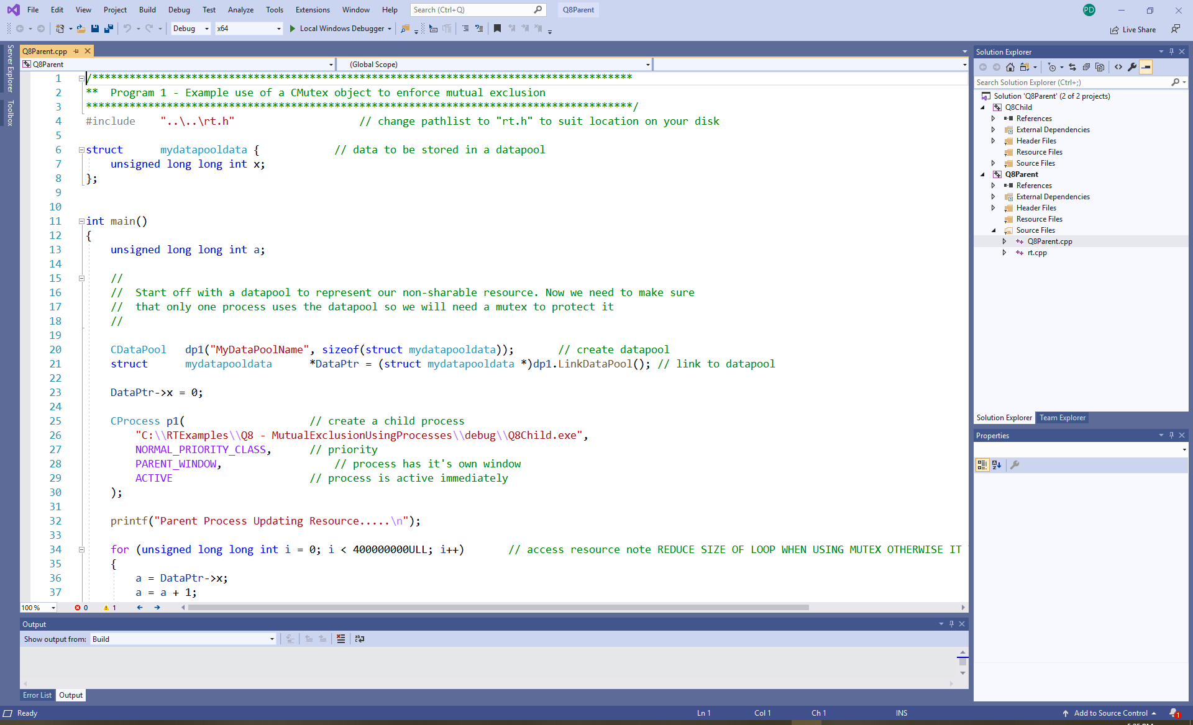
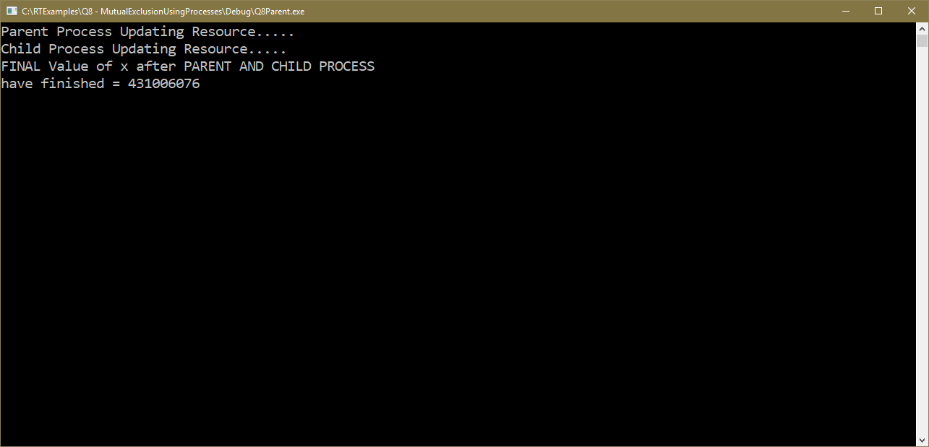
Q8 – Mutual Exclusion between two processes: Answer should be 800,000,000, actual answer varies each time program is run. Program takes about 6 seconds on my machine

Slide 11
Mutual exclusion in a multi-threaded systems using shared variables
int a = 0 ; // thread wide global variable
UINT _ _stdcall Thread1(void *args) // child thread function
{
for (int i = 0; i < 100000000; i ++) {
a = a + 1;
}
return 0 ;
}
void main() // primary thread within this process
{
CThread t1(Thread1, ACTIVE, NULL) ; // create a child thread
for (int i = 0; i < 100000000; i ++) {
a = a + 1;
}
t1.WaitForThread() ; // wait for thread to finish
}
Access to shared variable
Access to shared variable
Same Problem. Both threads could read/increment/write back result at or near same time and could be interrupted in the middle by a time slice.

Slide 12
A similar problem exists within active classes when two or more threads update the same class member variable, leading to possible corruption of the result.
class MyActiveClass : public ActiveClass {
private: int a ;
int func1(void *ThreadArgs)
{
while( 1 )
a = a + 1 ;
}
int main()
{
ClassThread <MyActiveClass> Thread1 ( this , &MyActiveClass::func1, ACTIVE, NULL) ;
while( 1 )
a = a + 1 ;
}
} ;
Class Child thread
Class Main thread
Same Problem. Both threads could read/increment/write back result at or near same time and could be interrupted in the middle by a time slice.

Slide 13
How do we solve
mutual exclusion in a
time-sliced environment?

Slide 14
Most novice programmers unfamiliar with multi-threading concepts might attempt to solve this problem using a global flag, i.e. a single byte (or bit) variable that indicates whether a resource is free (1) or busy (0).
This requires each thread continuously test the global system wide flag (using a “Busy Waiting” loop, also known as a “Spin Lock”) to establish whether the resource (the variable 'a' in this instance) is free, and if so, proceed to mark it as busy before accessing the resource (see below).
https://en.wikipedia.org/wiki/Busy_waiting
https://en.wikipedia.org/wiki/Spinlock
while( flag == BUSY ) // each thread tests the flag in its code
; // waiting for resource to become free
flag = BUSY; // once free, it can be marked as busy
Read the value of ‘a’
Add one to it
Store it back
flag = FREE ; // when finished, release for use by
// another thread
“Busy Waiting” loop or “Spin Lock”, repeatedly tests a flag until it indicates the resource is free.
Note: Very wasteful of CPU time
Possible Time slice ?
Critical Section of Code that
should not be executing in 2+ threads
at same time

Slide 15
Unfortunately this is not a solution, since the actions of testing the flag (part of the ‘while’ loop at the start), and marking it as busy (flag = BUSY) are not guaranteed to be indivisible either, since a time slice could occur between these two operations.
For example, two tasks (interleaved by time slices) could both test the flag (as part of their spin lock), both could see it as free and both could simultaneously mark it as busy before entering the resource at the same time.
In other words the problem has shifted from accessing and updating the resource ‘a’ to accessing and updating the flag protecting it.
Solution: Well just use another flag to protect the first flag (and another one to protect that, and another to….), i.e. a flag by itself will never work.

Slide 16
Solving Mutual Exclusion in Time sliced Systems
Back in the ‘60s when computer scientists were wrestling with how to solve mutual exclusion in time-sliced systems, many papers were published that offered solutions.
None of these solutions were ideal as they suffered significant limitations. That is they suffered from some of the following.
  They were complex and/or hard to follow or reason about
  They used “busy waiting” solutions (wasteful of CPU time, but not itself a problem)
  Their solution involved tasks arbitrating amongst themselves (i.e. taking turns)
  They only worked for two tasks and could not be scaled to solve Mutual Exclusion when an unknown number of tasks were competing to use a resource.
  Their solution was sometimes implicitly tied to knowledge about the architecture of the CPU and thus would not run on all machines.
Two of the most well known of those solutions are
  1) Dekker’s algorithm: https://en.wikipedia.org/wiki/Dekker%27s_algorithm
  2) Petersons algorithm: https://en.wikipedia.org/wiki/Peterson%27s_algorithm

Slide 17

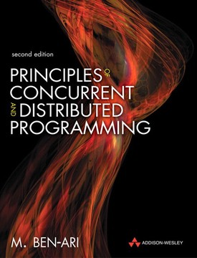
Back in the 80’s, “M. Ben-Ari”, a Professor at Tel-Aviv University wrote a classic text on concurrent systems (later updated to include distributed systems) that explained those solutions and described their limitations and why they did not work (or were inefficient) or non-scalable.
It was a wonderful book as it was described almost entirely using cartoon illustrations that involved Igloos and Eskimos representing resources and threads. A good read if you are interested.

Slide 18
So what is a
Scalable Solution to
Mutual Exclusion in a
Time Sliced System?

Slide 19
Solution 1: Use a Flag BUT Disable Interrupts while we test and set it
Analysing the problem, we see that it is the action of the real-time clock (RTC) triggering a time-slice part way through a critical section of code that causes the problem.
One possible solution would be to disable the RTC interrupts during the critical section of testing the flag and setting it, as shown below. Notice how interrupts have been enabled twice. Can you think why?
while( 1) {
disable interrupts
if ( flag = = FREE) {
flag = BUSY; // resource free so grab it and mark it as busy
enable interrupts; // now we have the resource, re-enable T.Slicing
break; // break out of ‘while’ loop
}
else {
enable interrupts ; // Question: What is this for ?
Sleep(0); // force a time slice each time around loop
} // to save CPU time
}
Read the value of ‘a’
Add one
Store it back
flag = FREE ;
Each task has this code to update ‘a’
Pre-entry code for each process, replicated in each program
Critical Section of Code
Exit code after resource updated

Slide 20
Drawbacks to this Approach
It requires rather nasty and very critical system specific code to be written within each task using a non-sharable resource.
(We could turn the code into a function which can be called, so this is a minor problem.)
Disabling interrupts invites programmers to abuse it or use it incorrectly (e.g. forgetting to turn it back on again). Do you really want to give programmers that power?
Each program still uses a ‘busy-waiting’ loop or “spin lock” which wastes large amounts of CPU time but achieves nothing while the resource is in use by another thread.
There is a possibility of indefinite lockout since there is no natural queuing mechanism to order the tasks and release them to use the resource in the order they arrive. In effect, a task might always be testing the flag and always find it busy, even though other tasks manage to test and set it and use the resource successfully.
Point 4) above would lead to non–deterministic behaviour, where the execution time of a task cannot be calculated any more.
It doesn’t work well in a multi-core or multi-cpu systems where all cores and cpus would have their time slicing disabled, even if they were not involved in the problem.

Slide 21
What about Multi-Core and Multi-CPU Systems?

Slide 22
Mutual Exclusion Problems in Multi-Processor/Multi-Core Systems
The same issue of Mutual Exclusion exists between two tasks running on separate CPUs/Cores when both attempt to access a shared resource, (e.g. 'a' in our data pool).
It’s possible that both could update ‘a’ at more or less the same time interleaved by separate bus-cycles to memory as shown below.
CPU/Core P1
Actual ‘a’
CPU/Core P2
Miscellaneous
Miscellaneous
Miscellaneous
0
Miscellaneous
Read value of a (0)
Data
0
Data
Read value of a (0)
Read value of a (0)
Read value of a (0)
Add 1 to value (1)
Add 1 to value (1)
Add 1 to value (1)
Add 1 to value (1)
Store back a (1)
Data
1
Data
Store back a (1)
Store back a (1)
Store back a (1)
Miscellaneous
Error: ‘a’ has only been incremented once instead of twice
Miscellaneous
Miscellaneous
Miscellaneous

Slide 23
Solving Mutual Exclusion in a Multi-CPU/Multi-Core System: Test and Set
The solution for multiple CPUs and multiple cores is for them to co-operate when using a shared resource using a specific CPU synchronisation instruction, guaranteed to test and set a flag as one indivisible or atomic operation.
This involves using a specific Machine code instruction which is unique in that it updates a variable (i.e. reads its value, changes it and stores it back) without letting go of the memory location where the variable is stored, i.e. without releasing control of the memory’s address and data buses, thus preventing access by another processor.
That is, the instruction “locks” the system memory bus for the duration of updating a single variable, which could in fact be the flag that indicates if the resource is free or busy
Note: This instruction has no equivalent in ‘C’, it has to be coded in assembly language but it can be put into a function within a library and could be called by our programs.
In other words, if a single instruction could test and set a flag in one non-interruptible memory access, then it would allow CPUs and multiple cores to synchronize themselves, so that only one of them accesses the shared resource at a time.
Crucially it would also be a solution for a time sliced environment. It’s not perfect and has some drawbacks, but at least it’s a scalable solution that works for both time-sliced and multi-core solutions. However the host CPU has to support the Test and Set Instruction which fortunately most advanced CPUs do these days.

Slide 24
(see http://en.wikipedia.org/wiki/Test-and-set)
The “Test and Set ” (TAS) Instruction
Many processors (aimed at multi-CPU/Core applications) implement this concept using some kind of “Test-and-Set” instruction
As mentioned earlier, this single instruction
  Reads the current value of a flag (stored at a specified address).
  Sets the value of that flag to ‘1’, regardless of the value previously read .
  Indicates to the executing program the previous value of the flag, i.e. the value of the flag before TAS set it to 1.
Thus, if TAS indicates 0, your program will know that the resource the flag was protecting was free prior to executing TAS and that now it has been marked it as busy (by setting it to 1).
If however TAS indicates 1, your program will know that the resource was in use by another thread at that time and thus you will have to try TAS again later. Note that in that case, the act of setting the flag to ‘1’ will be harmless since it would already have been 1 anyway as the resource was busy.

Slide 25
Example Assembly program showing how to gain access to a resource using TAS
You could arrange for all your tasks to include the following assembly language code into their programs before attempting to gain access to the resource. This could be tuned into a library function to hide the assembly language if required.
entry: TAS $10000 Test and set a flag assumed to be at location hex 10000
bne entry branch back if value of read flag NOT zero i.e. = 1 (busy)
access ..... Got sole use of resource, do what I like to it now !!!
….. Modify data in the resource
…..
exit: clr.b $10000 Clear flag to release resource when we are done using it
Again this form of busy-waiting loop is very wasteful of CPU time. In addition it also suffers from the same problems of potential indefinite lockout and non-deterministic behaviour as the disabling Interrupts approach (page 18), but it works for both time sliced and multi-core environments.
“Busy Waiting” Loop or “Spin Lock”

Slide 26
Note that Reading a flag followed by a write using two separate instructions does not work. Here’s the timing diagram to show why not. Two CPUs/cores/threads could read the flag (in an interleaved manner), both see it as 0 (free) and both set it to 1 to mark it as busy. Both then use the resource at the same time – Result: FAIL!!!!
CPU 1
e.g. 10nS
Check Flag (0)
e.g. 10nS
Address Bus
Read Flag
Write Flags
R/W Signal
1
0
Data In
0 (Free)
Data Out
1 (Busy)
CPU 2
e.g. 10nS
Check Flag (0)
e.g. 10nS
Address Bus
Read Flag
Write Flag
R/W Signal
1
0
Data In
0 (Free)
Data Out
1 (Busy)

Slide 27
With a TAS instruction, the memory access timing diagram looks like this.
Assume both CPUs “TAS” together (worst case). Hardware arbitration ensures only one CPU is allowed to gain physical access to the memory at that time (the other must wait).
TAS reads from and then writes to the flag without letting go of the memory location.
CPU 1
CPU “locks” memory for full TAS
TAS takes twice as long to execute as a normal read or write
Address Bus
Read, Check then Write Flag
Note how R/W line changes value in the middle of the access
R/W Signal
1
0
CPU Data In
0 (Free)
CPU Data Out
1 (Busy)
CPU 2
CPU 2 executes TAS at same time as CPU1 – Hardware Arbitration gives memory to one CPU. In this example CPU 1
Address Bus
Read Check then Write Flag
CPU 2 has to wait for CPU 1 to complete
2nd CPU see flag is set/busy and has to retry the operation later
R/W Signal
0
CPU Data In
1 (Busy)
CPU Data Out
1 (Busy)

Slide 28
C++ 11 Atomic_flag variables
The C++ standards committee developed and generalised this TAS concept into something that is portable across OS platforms, i.e. a library function.
The result was an “atomic_flag” variable, which can be tested-and-set but only by threads in the same program as they need access to a shared “atomic_flag” object
It still has drawbacks however (e.g. a spin lock is still used, there is no queuing, and there is still possibility of indefinite lockout etc.) and it only works between threads, not across process boundaries, but it works.
#include <atomic>
atomic_flag flag;
long x = 0;
// A child thread to update x
UINT __stdcall Thread1(void *args)
{
cout << "Child running\n";
for (long i = 0; i < 50000000L; i++) {
while (flag.test_and_set() == true)
;
x = x + 1;
flag.clear();
}
return 0;
}
See example Q8….TestAndSet in RTExamples
// The main thread in the process
int main()
{
flag.clear();
CThread Child(Thread1);
cout << "Parent running\n";
for (long i = 0; i < 50000000L; i++) {
while (flag.test_and_set() == true)
;
x = x + 1;
flag.clear();
}
Child.WaitForThread();
cout << "Final x = " << x << endl;
getchar();
return 0;
}
spinlock
spinlock

Slide 29
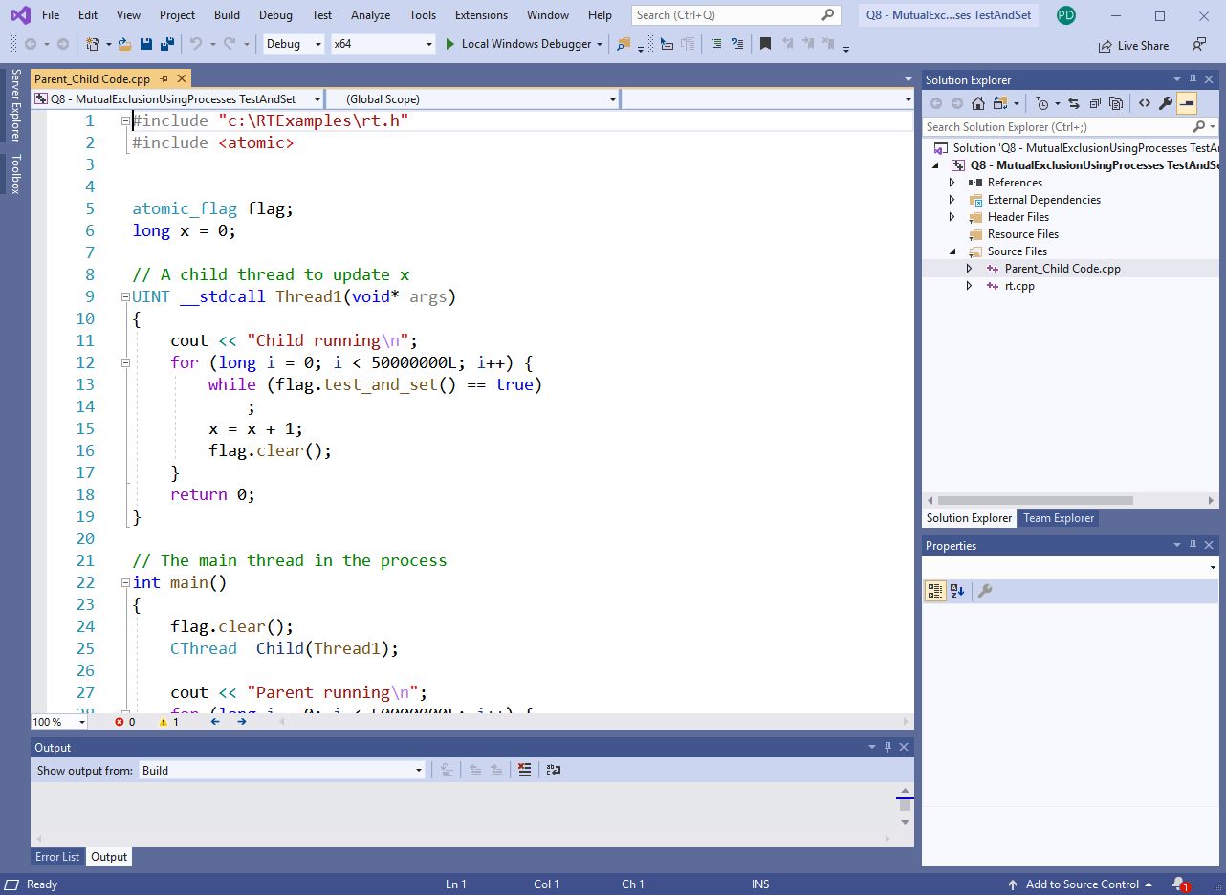
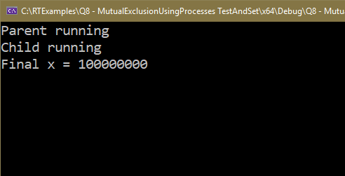
Q8 – Mutual Exclusion between two processes using Test and Set: Produces correct answer of 100,000,000. However Program takes MUCH longer to run due to the call to test_and_set()

